Slide 1
Drafting Research Paper & Publishing it in UGC-CARE and SCOPUS Indexed Journals
Presented by,
Dr.Vijay B.Gadicha
Associate Professor
G H Raisoni Group, Nagpur

Slide 2
Session Targets
Drafting a Research paper.
Publishing paper in conference.
Publishing paper in Peer Reviewed Journals.
Process of Rapidly publishing the paper in reputed/free journals.
Conclusion.

Slide 3
Drafting a Research paper
Research Paper Writing
Review Paper
Research Paper

Slide 4
Drafting a Research paper (cont…)
Contents of the paper (Format)
Abstract
Introduction
Literature Survey/Review
Proposed Work
Result Analysis & Findings
Conclusion & future scope
Reference list (to be cited)

Slide 5
Plagiarism
Research Ethics must be preserved by drafting original and pure contents by respective author/s
To accomplish that, Plagiarism is a mechanism which we will use.
Types of Plagiarism
Direct Plagiarism Self Plagiarism

Slide 6
Publishing Paper in Conference
Following Points must be taken in Consideration before submitting the paper in conference.
Conference theme / tracks
Organization / Association
ISSN/ISBN number for Proceedings
List of Journals where Presented papers can be published.
Indexing of such Journals.

Slide 7
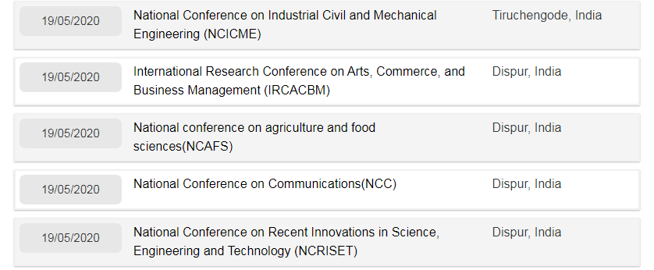
Contd..
https://www.conferencealerts.in/

Slide 8
Publishing paper in Peer Reviewed Journals
Peer review is the evaluation of work by one or more experts with similar competences as the author of the work.
Peer review Process is intended to serve as a filter to ensure that only high quality search is published.

Slide 9
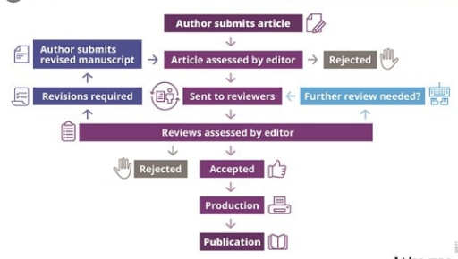
Peer Review Process

Slide 10
Publishing Paper in UGC-CARE Journals
Publication in Journal
Paid Journals
Unpaid / Free Journal

Slide 11
Publishing Paper in UGC-CARE / SCOPUS Journals
Following observations may be taken in consideration before publishing the paper in any Journal.
Indexing of the journal
UGC-CARE Journal
Scopus Index
SCI Index
WOS index etc

Slide 12
Publishing Paper in UGC-CARE / SCOPUS Journals
Impact Factor:
IF = Number of Article Cited / Total No of Articles
ISSN (International Standard Serial Number)
Journal is Peer reviewed or Not

Slide 13
Publishing Paper in UGC-CARE / SCOPUS Journals
Submission Process:
Submission can be done by some of the following ways:
Emailing the paper to Editor of the Journal
Uploading the paper on the Journal Portal
Uploading the paper on some third party portal associated to journal

Slide 14
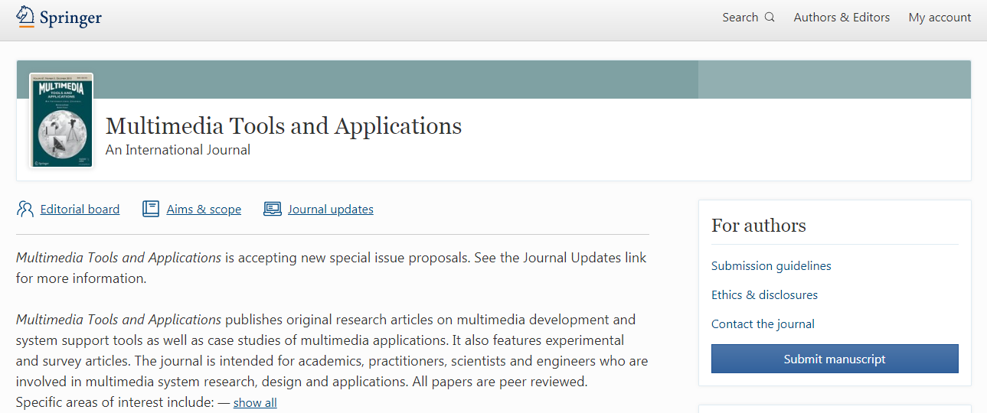
Publishing Paper in UGC-CARE / SCOPUS Journals
Case Study:
Submitting the paper in a Scopus indexed journal

Slide 15
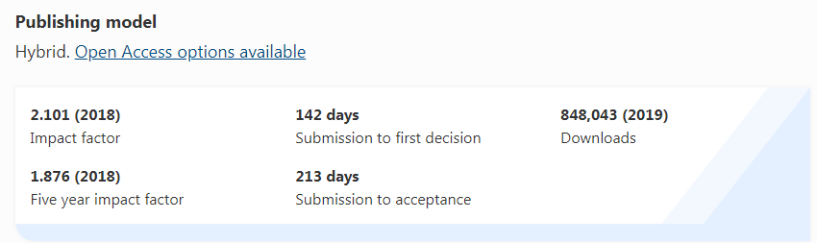
Publishing Paper in UGC-CARE / SCOPUS Journals

Slide 16

Process of Rapidly publishing the paper in reputed/free journals

Slide 17


Slide 18
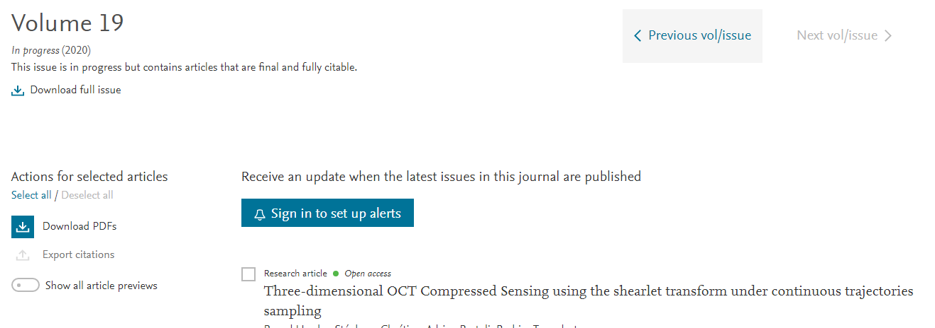

Slide 19
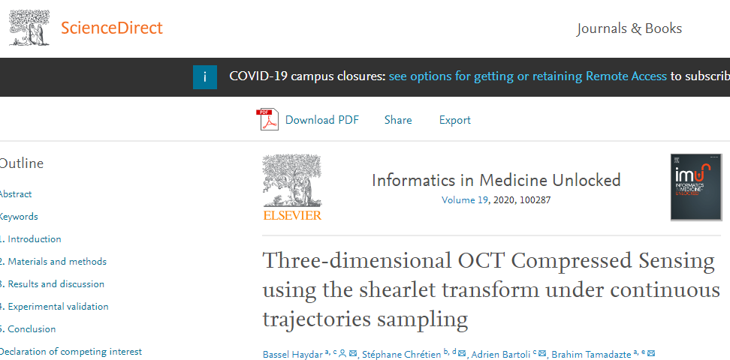

Slide 20
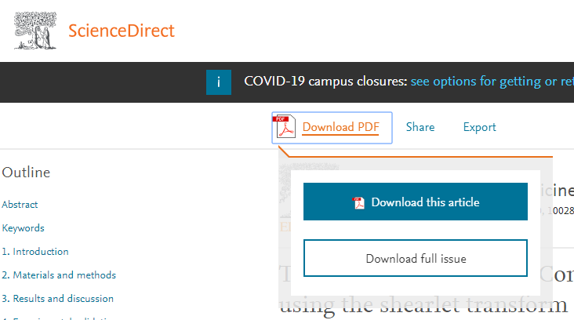

Slide 21
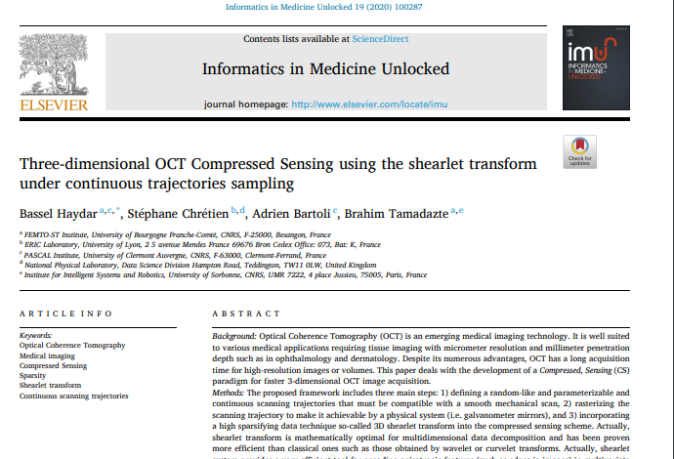

Slide 22
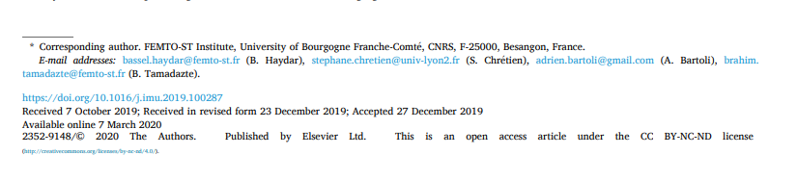

Slide 23
Thank you
Research comes from the need of the society.

